Slide 1

Cyber Security Attacks Analysis

Slide 2
Analysis of Cyber Security Attacks taken from Kaggle
1
2
3
Source the Dataset
Hypothesis
Cleaning the Data
4
5
6
Visual analysis of the data
Linear Regression models
Insights

Slide 3
The following data set will be referenced from https://www.kaggle.com/datasets/teamincribo/cyber-security-attacks/data
The dataset comprises 40,000 records and 25 distinct metrics, including network and security attributes such as timestamps, IP addresses, ports, protocols, packet details, payload data, malware indicators, anomaly scores, alerts, attack signatures, user and device information, geo-location, firewall and IDS/IPS logs, and more.
Analysis of Cyber Security Attacks taken from Kaggle

Slide 4
We propose the following hypotheses based on the dataset, which we aim to validate or refute through analysis:
DDoS attacks constitute the majority of cybersecurity threats.
There has been a increase of cybersecurity attacks over the past 5 years.
Using time-series trend analysis (via linear regression), the monthly frequency of cyber attacks will be forecasted
Hypothesis

Slide 5
The following dataset has null values in the following columns
Malware Indicators
Alerts/Warnings
Proxy Information
Firewall Logs
IDS/IPS Alerts
clean.py will be used to clean the dataset before plotting the values.
Cleaning the data

Slide 6
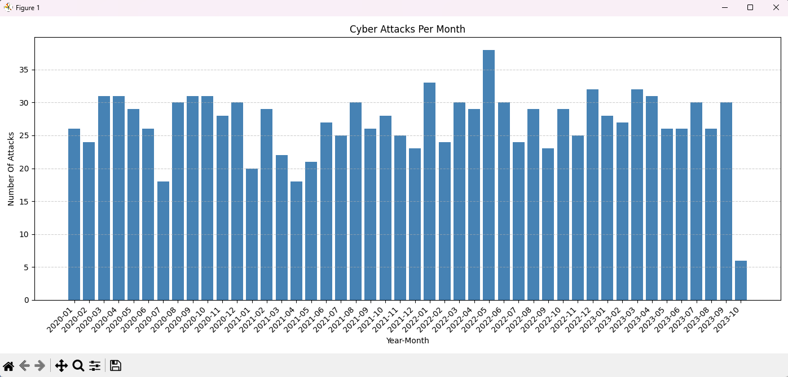
Hypothesis: There has been a increase of cybersecurity attacks over the past 5 years.
Plotting the dataset we see that the trends per month has not risen significantly or decreased significantly.
Visual Analysis of the Data

Slide 7
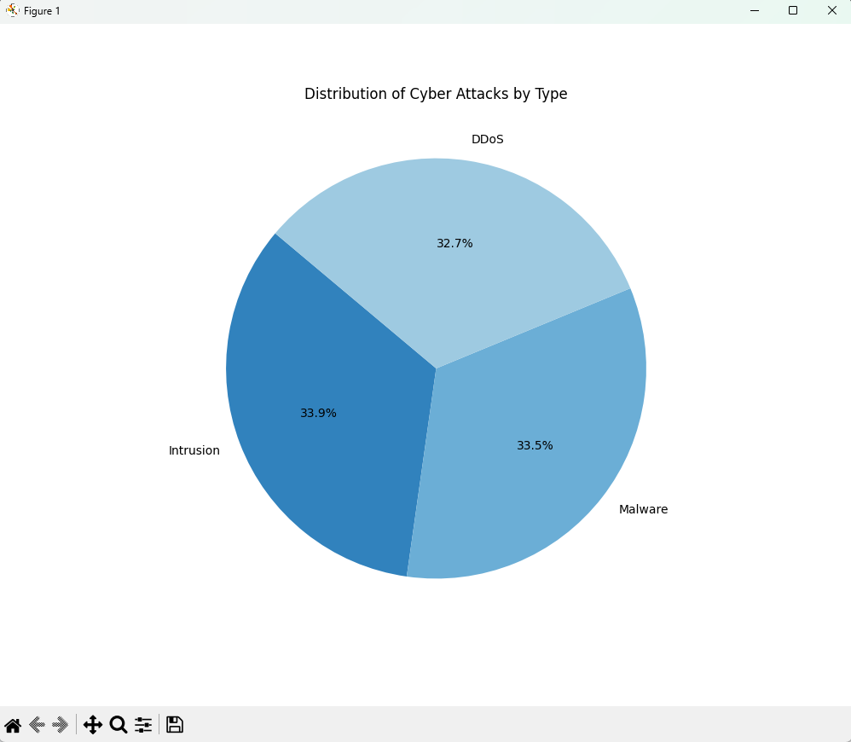
Hypothesis: DDoS attacks constitute the majority of cybersecurity threats.
Visualizing the dataset reveals that DDoS attacks do not dominate the threat landscape; instead, malware and intrusion-based attacks occur at comparable rates, indicating a more evenly distributed pattern of cybersecurity incidents.
Visual Analysis of the Data

Slide 8
Linear Regression: Statistical Method to model the relationship between a dependent variable and one or more independent variables by fitting a straight line through the data points.
We want to predict the number of cyber attacks per month.
Independent variable: Time
Definition: The variable that you control or use to make predictions
Dependent variable: Number of cyber attacks per month
Definition: The variable we’re trying to predict
Linear Regression Models

Slide 9
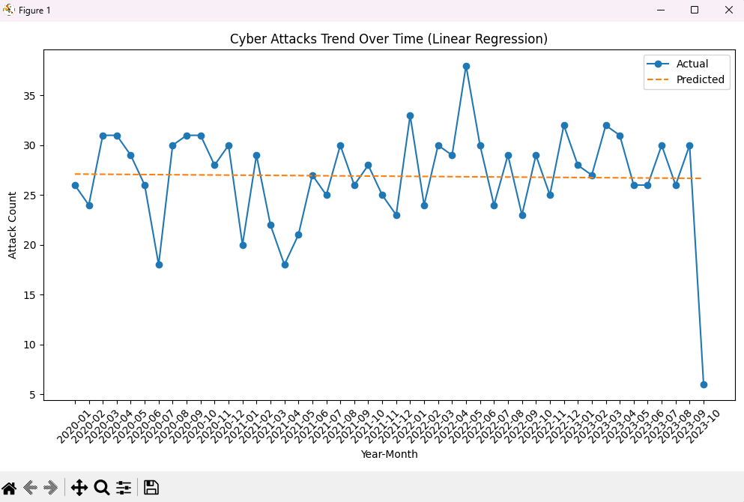
Hypothesis: Using time-series trend analysis (via linear regression), the monthly frequency of cyber attacks will be forecasted
The above image we use the independent variable time to predict the attack count(dependent variable)
Simple Linear Regression Models

Slide 10
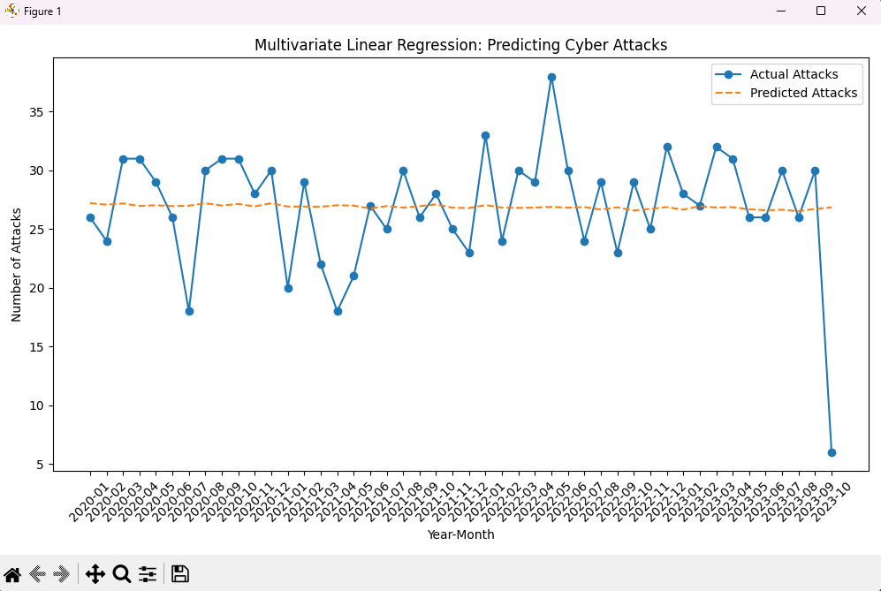
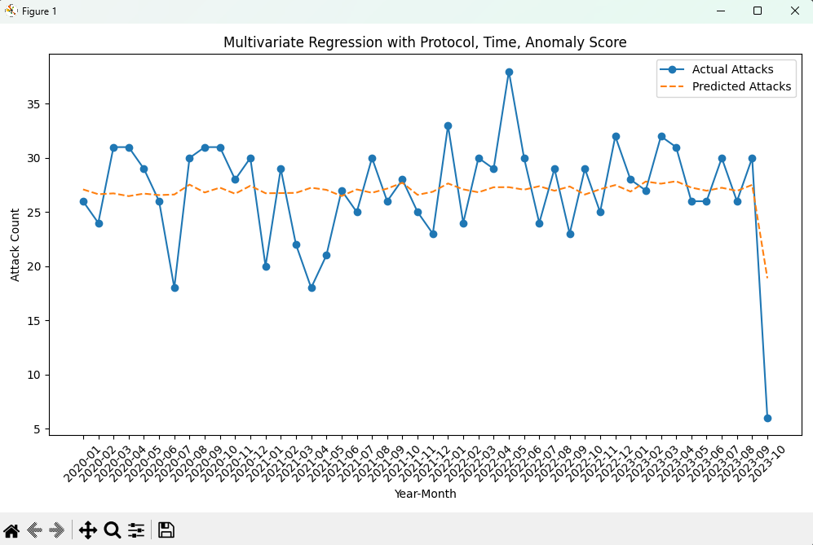
Hypothesis: Using time-series trend analysis (via linear regression), the monthly frequency of cyber attacks will be forecasted
The above image on the left we use the independent variable time and anomaly to predict the attack count(dependent variable)
The above image on the right we use the independent variable time, anomaly and protocol to predict the attack count(dependent variable)
Multivariate Linear Regression Models

Slide 11
One-hot encoding
Method for converting categorical variables into a binary format.
Reason: Protocol is a str format
For our multivariante example we convert Protocol into binary format, this way the model can see all protocols as separate, unrelated categories.
https://www.geeksforgeeks.org/machine-learning/ml-one-hot-encoding/
Insights

Slide 12
Thank you

